Slide 1
Web Dev Project
Online library platform
PRESENTATION

Slide 2
Web Dev Project
B. Tech CSE(core)
Semester 3rd
Librohub:
an online library platform
PRESENTATION

Slide 3
Developers
B. Tech CSE(core)
Semester 3rd
Aryan (2401010005)
Aman (2401010141)
Mahin (2401010123)
Bhavik (2401010039)

Slide 4
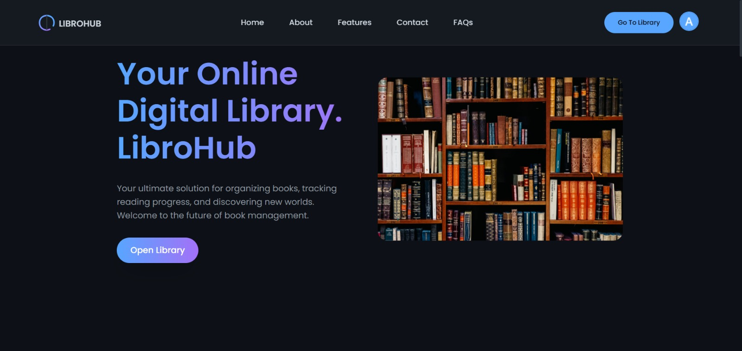
Hero Section
B. Tech CSE(core)
Semester 3rd
Aryan (2401010005)
Aman (2401010141)
Mahin (2401010123)
Bhavik(2401010039)

Slide 5
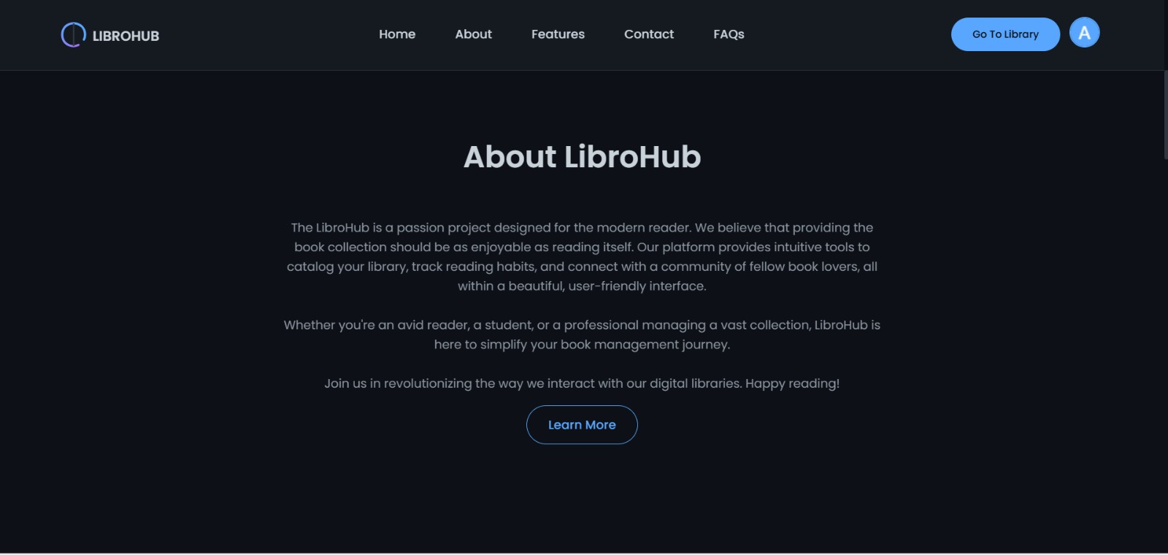
Hero Section
Why we need this?

Slide 6
Why we need this?

Slide 7
Why we need this?
Enables quick search and retrieval of book details.
Stores all data securely in a digital database.
Saves time by allowing fast add, update, and delete operations.
Reduces human errors and data duplication.
Makes inventory tracking easier and more accurate.

Slide 8
Existing System
Issuing and returning books require manual entries.
Searching for books or records takes a lot of time.
Updating or deleting records is tedious.
Proposed System
Issue, return, and search operations are automated.
Reduces manual effort.
Minimizes human error.
Reports can be generated quickly.

Slide 9
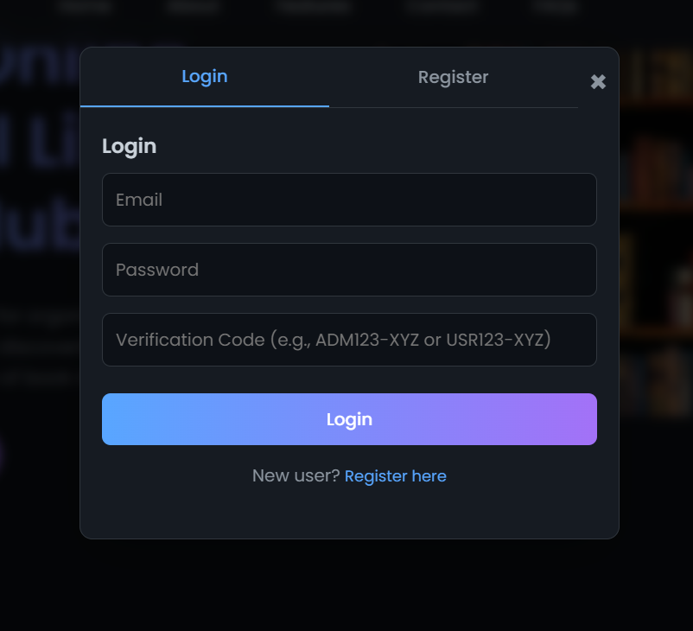
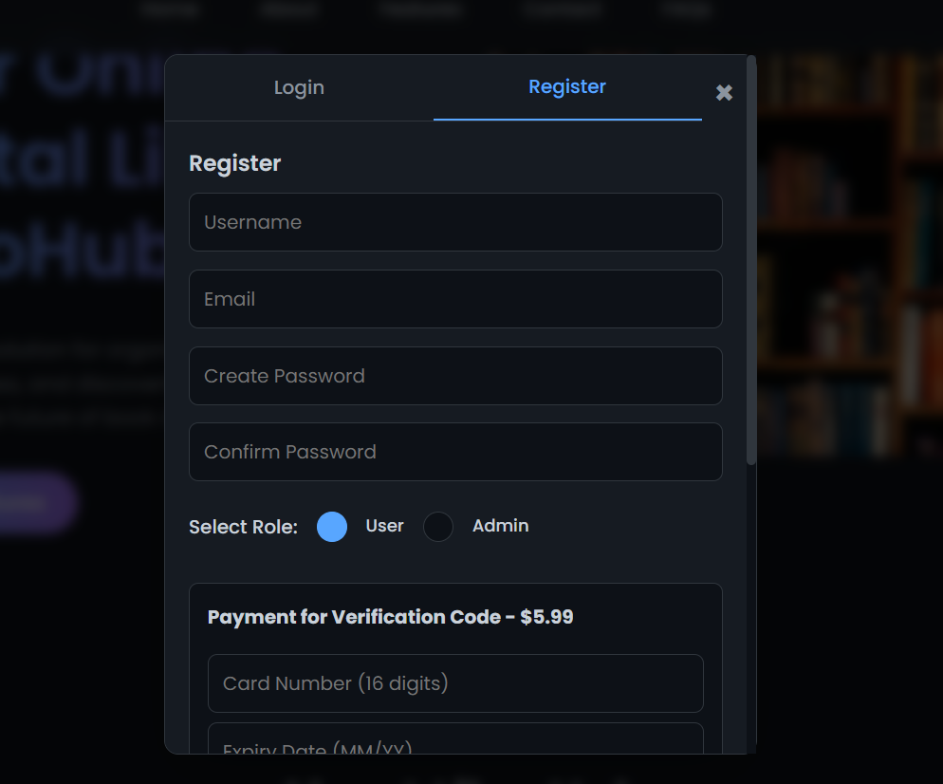
Login and registration

Slide 10
Admin Module
Admin Authentication
Manage Books
Issue & Return Management
Generate Reports
Database Maintenance
User Module
User Login & Registration
Search and View Books
Book Issue Request
Book Return Request
View Account Details

Slide 11
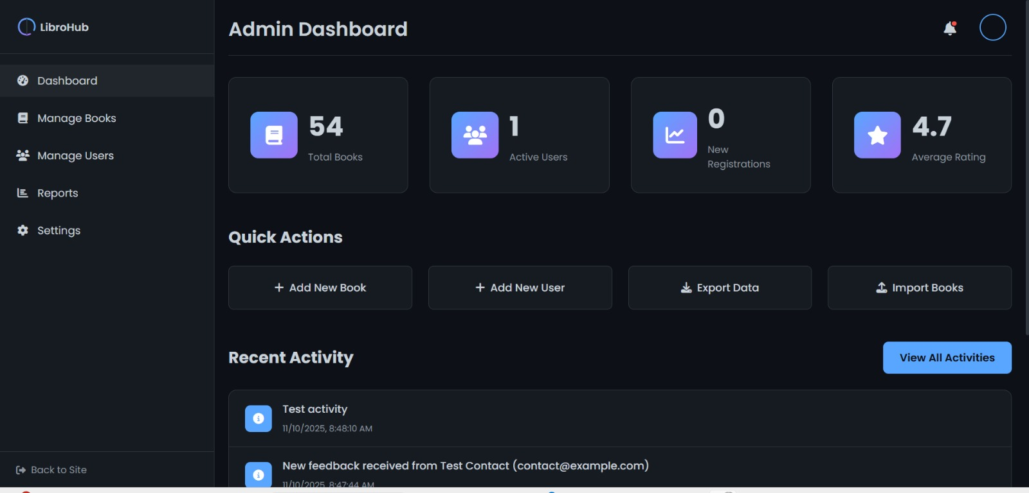
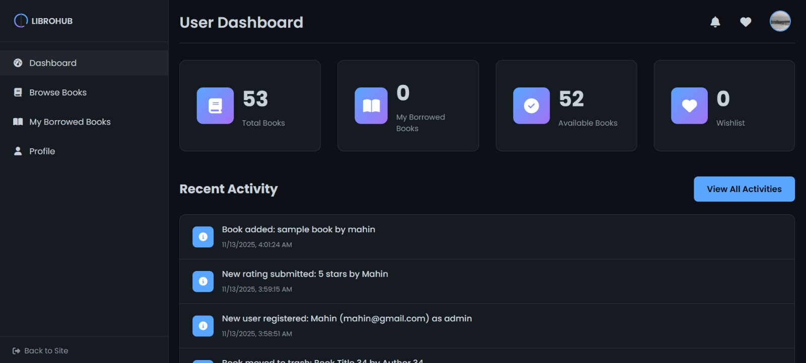
SYSTEM ARCHITECTURE

Slide 12
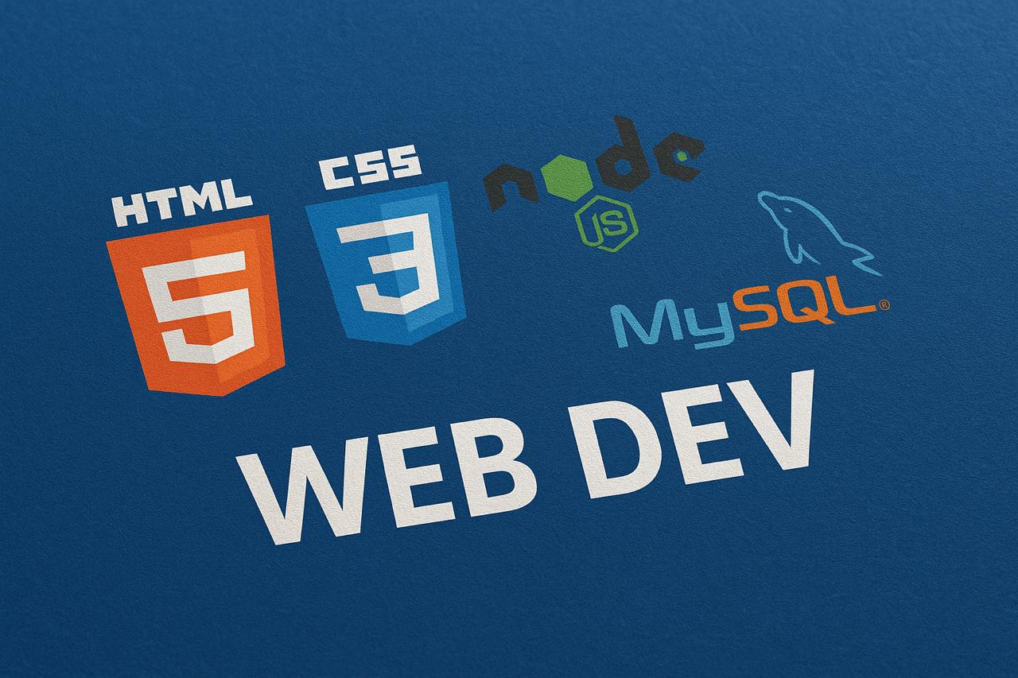
TECHNOLOGIES USED
HTML
CSS
Node JS
MySQL

Slide 13
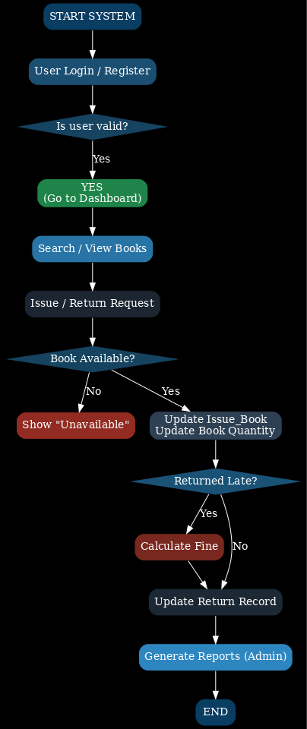
SYSTEM FLOW
The online library platform follows a clear and logical workflow that connects Admin and Users.

Slide 14
This Online library platform provides an efficient, reliable, and user-friendly way to handle all library operations digitally. It automates major tasks such as book issue, return, search, fine calculation, and report generation, reducing manual effort and errors.
CONCLUSION

Slide 15
THANK YOU

